Slide 1
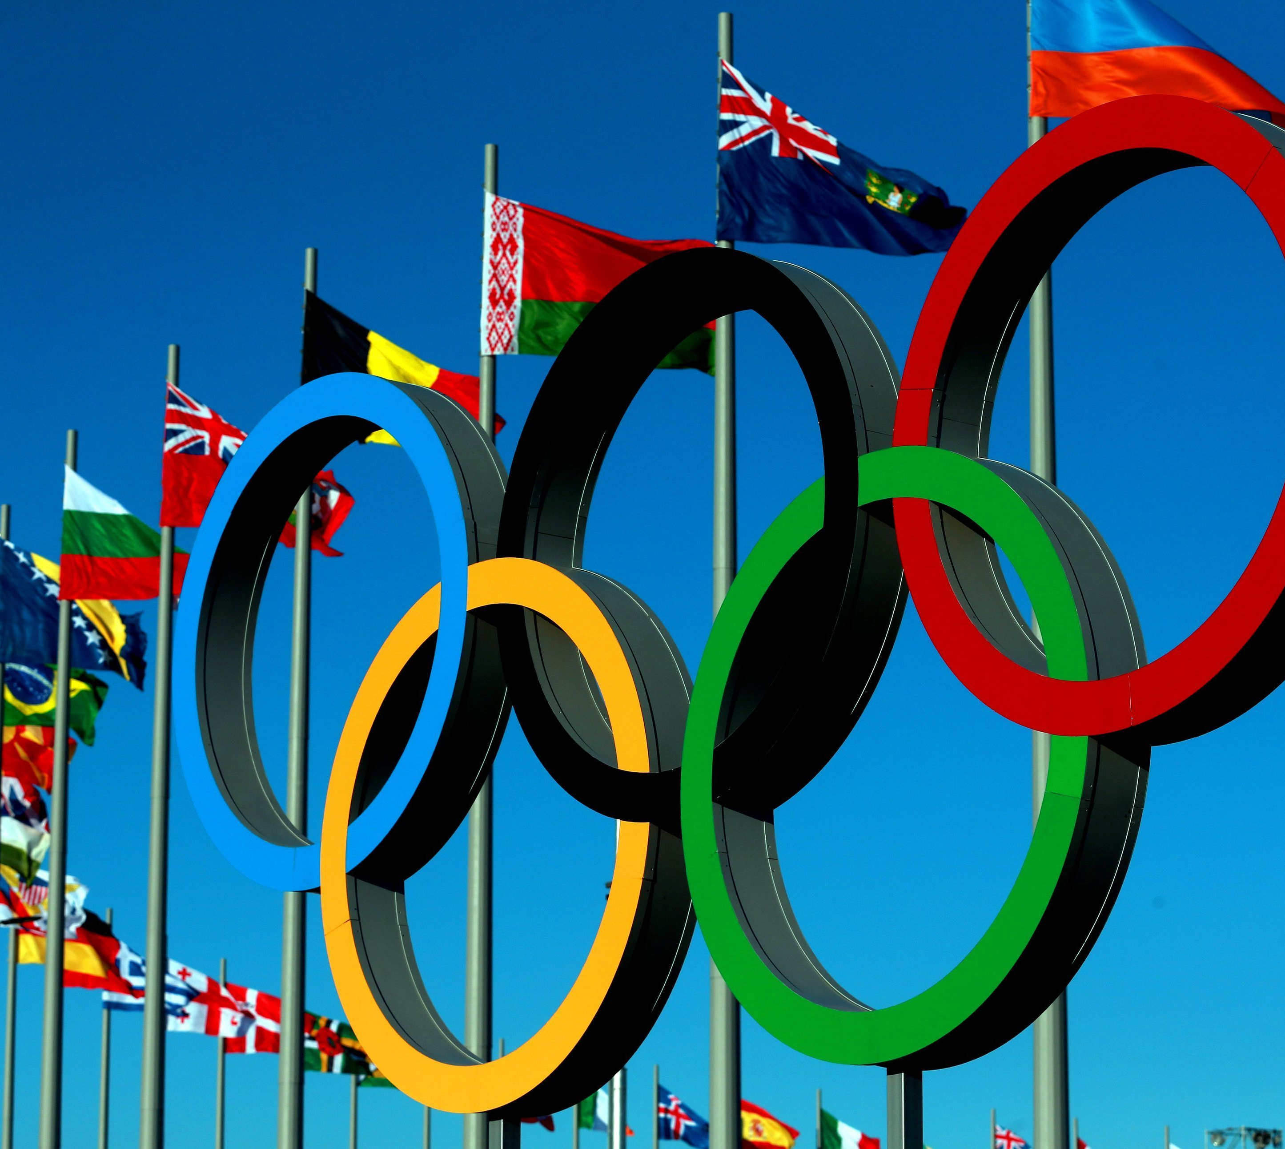
Project 3:
Olympic data
Group Members:
Ruchi
Calum
Minnie
Mohamed

Slide 2
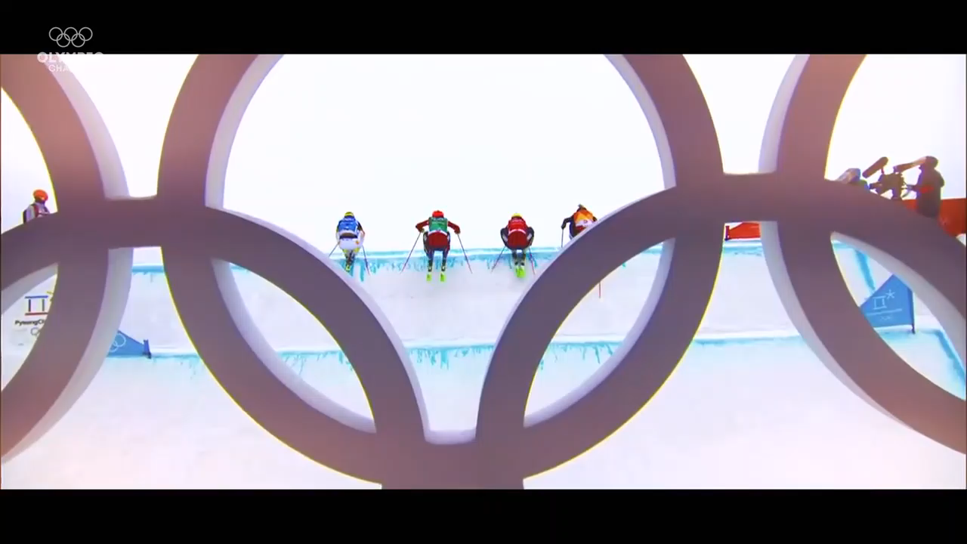
PRoJECT 3 BACKGROUND
For the project, our group decided to chose the theme of the Winter Olympics starting from the Sochi 1994 to the Chamonix 2014.
The areas that we are delving into are:
The number of medals that have been won by each participating country.
The gender split throughout the years from the Athletes that are competing in each Olympic event.
The home countries that have held the Olympic game and how well they have done since.

Slide 3
Data and data delivery
Data file
Variables:
Time frame
A CSV file containing data for all Olympics game till the Rio 2016 Olympics
Variables that were looked into:
Gender
Team Country
Event
Medal
The span of tournaments was shorted down to just Winter Olympics due to the number of Columns within the data being too much.
restrictions
delivery
Restrictions that were faced was that

Slide 4
Visualizations
Index (HOMEPAGE)
Dropdown​

Slide 5
Gender Split throughout the Olympics
Insert Graph

Slide 6
Project Summary

